Slide 1
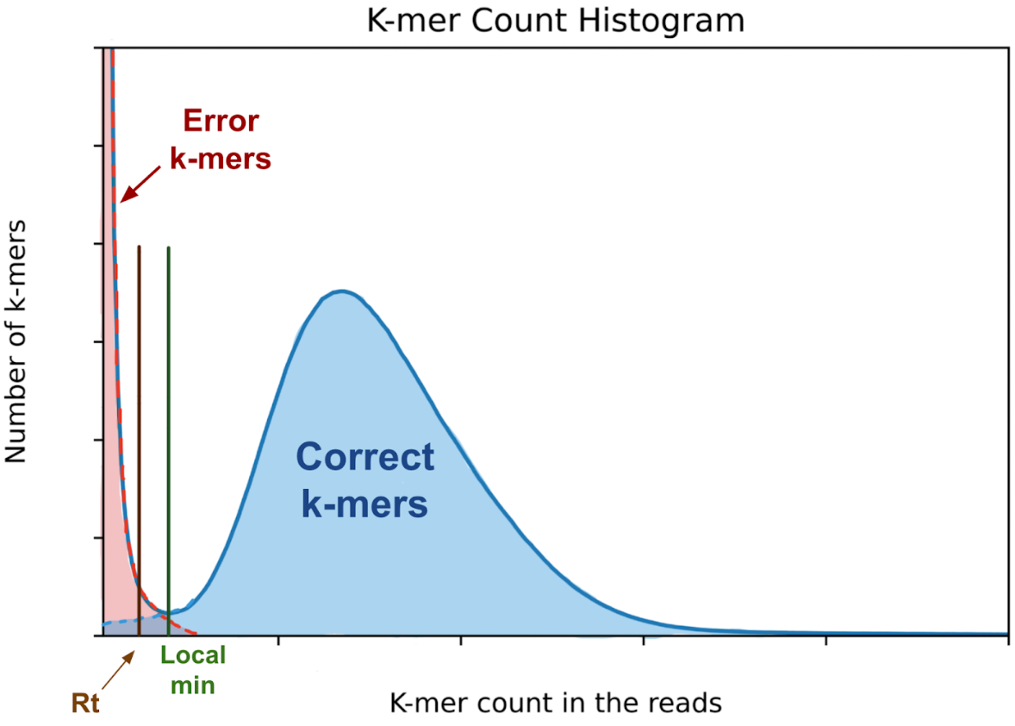
K-mer count histogram
Count occurrences of all K-mers in the reads (jellyfish count)
Bin the counts and plot histogram of how many K-mers have counts that fall into each bin (jellyfish histo)
Choose threshold
K-mers that occur in the reads with counts > threshold must be in the assembly
Can use this technique to estimate genome size as (# of correct K-mers)/(K-mer coverage)
~Exponential distribution
K-mer coverage
Poisson or
Negative binomial distribution

Slide 2
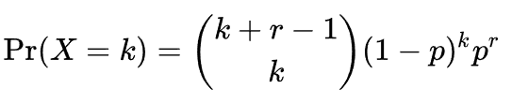


K-mer count histogram
Negative binomial distribution,
Binomial coefficient:
Mean
~Exponential distribution
K-mer coverage
Negative binomial distribution

Slide 3
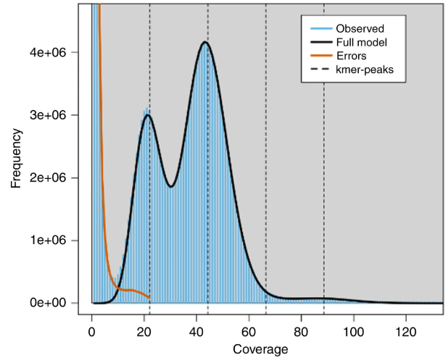
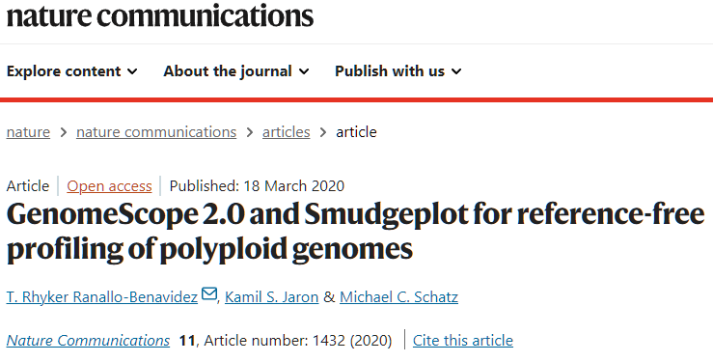
Challenge
What does this histogram tell us:
Image credit:

Slide 4
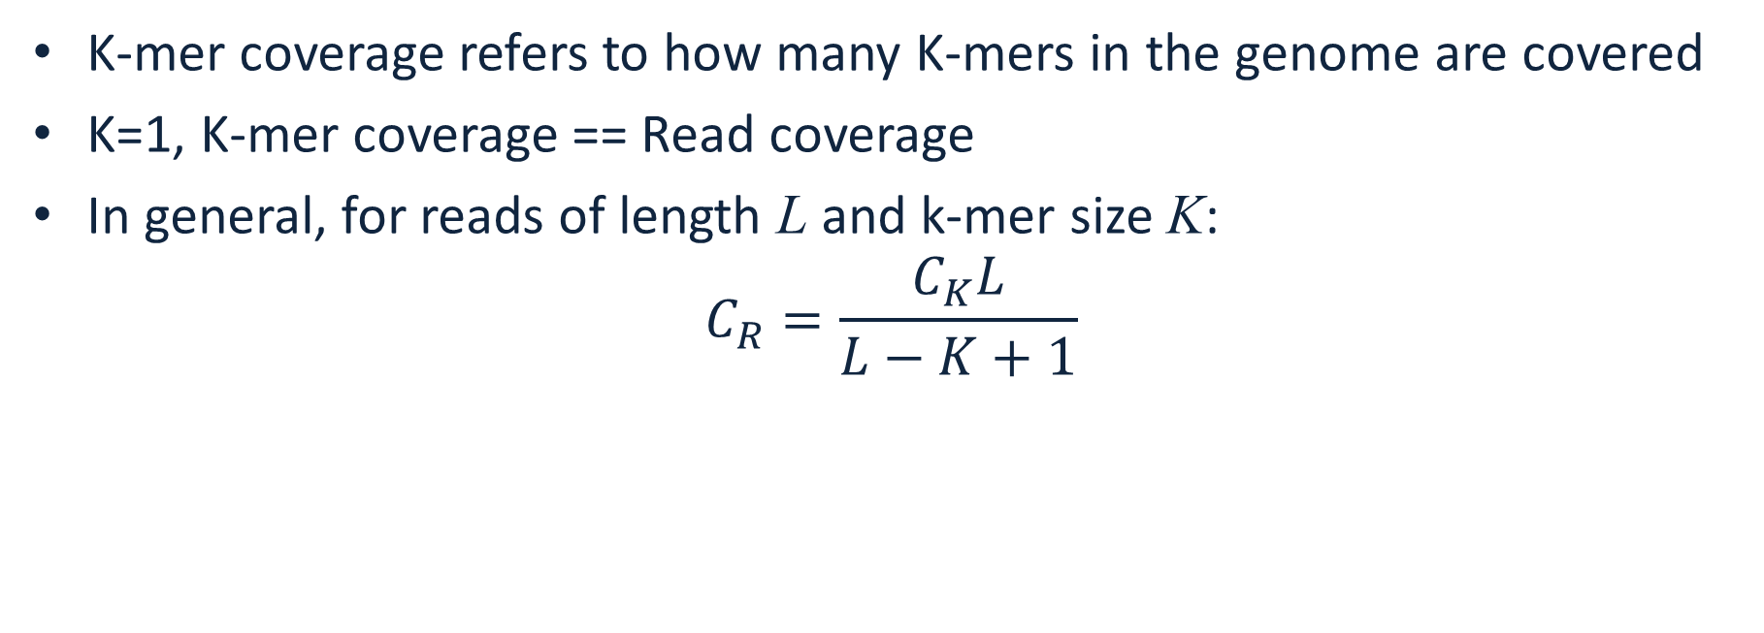
K-mer coverage vs Read coverage
K-mer coverage refers to how many K-mers in the genome are covered
K=1, K-mer coverage == Read coverage
In general, for reads of length L and k-mer size K: $C_{R}=\frac{C_{K}L}{L−K+1}$

Slide 5

How to count K-mers
Jellyfish is a versatile tool
Fast (multi-threaded)
Space-efficient
C++ library
Perl, Ruby and Python bindings
Can load and query k-mer counts database from these languages

Slide 6
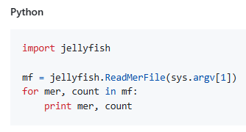
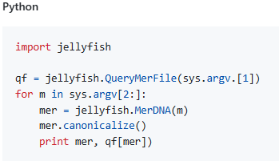
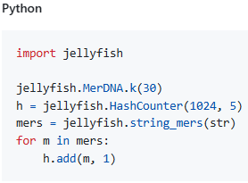
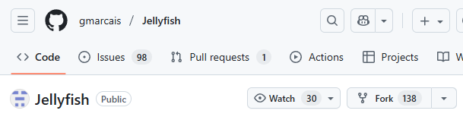
Python binding
Allows to load, query database
Jellyfish dump Jellyfish query Jellyfish count

